Slide 1
Floyd Warshall
Bishop Swearingen

Slide 2
Floyd Warshall Algorithm
The Floyd Warshall Algorithm is a greedy algorithm that searches for the shortest path within a graph with weighted edges.

Slide 3
Time and Space Complexity
The Warshall Algorithm has a time complexity of O(V³) and a space complexity of O(V²). In comparison, similar algorithms like Dijkstra's algorithm has a time complexity O(V^2+E) or the Bellman-Ford algorithm that has a time complexity of O(E + V log V).

Slide 4
General Description
Floyd Warshall finds the shortest path in a graph by considering the distances between nodes in a matrix. The matrix initially just contains the distance between adjacent nodes and then the algorithm looks at all intermediate nodes and updates the matrix with the shortest path.

Slide 5
Floyd Marshall
The algorithm initializes a matrix of the distances between pairs of nodes
The algorithm iterates through every intermediate node between to 2 nodes.
If the current node path is shorter than the previous node path consider the algorithm updates the current path to the new shortest path.
The algorithm will repeat the process until every path is considered and the shortest path is found.

Slide 6
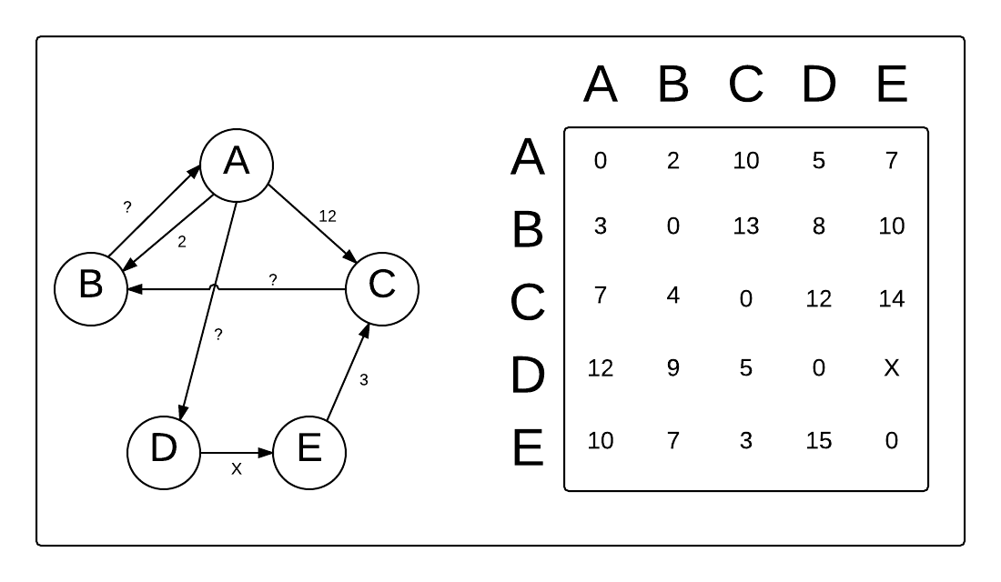
Step 1: Matrix
Create a n x n matrix A⁰ of all the distances between all of the vertices. i and j will represent the rows and columns and represent the vertices of the graph. If there is no path between i and j in the matrix, mark the index with infinity.

Slide 7
Step 2: Create a new matrix
After creating the first matrix, create a new matrix A¹ that contains the same first row and column of the matrix A⁰. Next fill in the rest of the matrix by comparing the direct path of the current vertex with the pair of intermediate vertices. The shorter of the two will fill the index in the matrix.
The formula for this is A[i][j] is filled with (A[i][k] + A[k][j]) if (A[i][j] > A[i][k] + A[k][j]) where i and j are the rows and columns of the matrix and k is the intermediate vertex.

Slide 8
Step 3: Keep comparing
The next step is create a new matrix now with the 2nd row and column that remains the same, and the previous step is repeated. The process will be repeated until on all possible paths are compared and the shortest path remains between each pair of vertices.

Slide 9
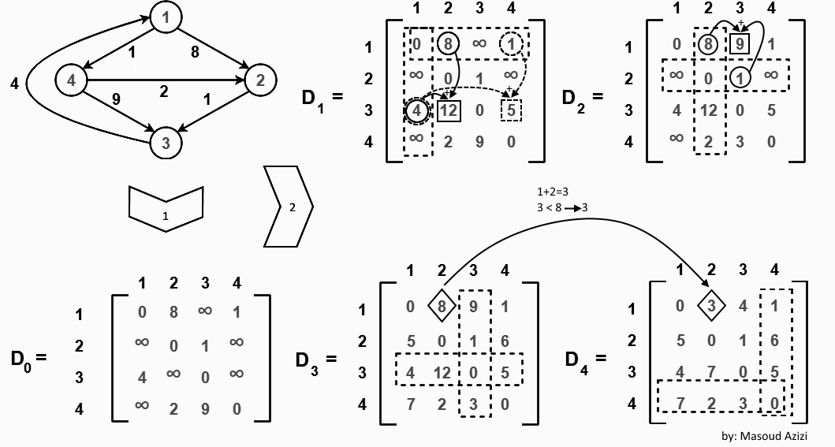
Example

Slide 10
Warshall Vs Dijkstra
Warshall and Dijkstra are both shortest path greedy algorithms. Dijkstra differs from Warshall by starting from a single node and keeping a list of visited nodes and finding the shortest path after all nodes are visited. In terms of which algorithm to choose, Warshall is better for graphs with many edges while Dijkstra is better for graphs with fewer edges.

Slide 11
Warshall vs Bellman-Ford
Bellman-Ford is another shortest path greedy algorithm similar to Warshall and Dijkstra. Also similarly to Dijkstra, Bellman-Ford differs from Warshall by starting from a single vertex instead of comparing pairs of vertices. Bellman-Ford and Warshall can both handle graphs with negative edges. Warshall is better at handling dense graphs with more edges, while Bellman-Ford is better for sparce graphs.

Slide 12
Works Cited
https://www.programiz.com/dsa/floyd-warshall-algorithm
https://www.youtube.com/watch?v=oNI0rf2P9gE
https://www.geeksforgeeks.org/floyd-warshall-algorithm-dp-16/

